Slide 1
Integrated Performance-Based Assessments
Moving Your State From
Performance To Proficiency:
The Ohio Model

Slide 2
Contact Information
Kathy Shelton Ohio Department of Education
Kathleen.Shelton@education.ohio.gov
Tel. 614-995-4840
Martha Pero Halemba
Ohio Foreign Language Association
Hudson City Schools, Hudson, Ohio
halembam@hudson.edu
Tel. 330-653-1416 ext. 3514

Slide 3
Handout For This Workshop
Handout :
Table of Contents (p. 1)
Notes pages (pp. 2 – 19)
IPA templates (pp. 20 – 22)

Slide 4
Moving Your State From Performance to Proficiency
Novice
Intermediate
Advanced

Slide 5
A. Ideas For Moving Your State From Performance to Proficiency
OFLA and ODE work closely together so that there is a consistent message.
Vertical alignment in your building, district and state is a must.
We used our Ohio Teacher Evaluation System (OTES) to drive the instructional shift. We took the lead and gave input into how our world language teachers would be evaluated.
The ODE Model Curriculum and the OFLA Weebly provide current and effective resources for our teachers: IPA samples, authentic resources, rubrics, Can-Do checklists, instructional and assessment tools, websites for language learners, and other resources.

Slide 6
A. Ideas For Organizing Workshops
We use the OFLA listserv and ODE announcements to organize workshops, spread the message, share ideas and answer questions.
We created a cohort of teachers that were trained to lead workshops on proficiency, modes of communication, and performance-based assessments.
We led (and continue to lead) workshops around the state to get teachers on board, including at the OFLA state conference.
ODE and OFLA continue to offer free or low-cost professional development around the state, for teachers who want to learn even more!

Slide 7
A. Additional Suggestions
For districts that only have 1 or 2 world language teachers, or are isolated from collaboration with other colleagues:
We encourage these teachers to form Professional Learning Networks for support and collaboration.
These teachers collaborate via Facebook Groups; Google Hangouts or Google Docs; email groups; periodic meetings for face-to-face collaboration, discussions, or guest speakers.

Slide 8
A. How Do I Run My Workshop?
We’ve created a Power Point framework that you can use to develop a 3 hour “Performance to Proficiency” workshop.
The Power Point is housed with all of the other documents for this workshop.

Slide 9
A. How Do I Run My Workshop?
Today’s workshop will be similar to how we run our Ohio workshops.
We incorporate continuous teacher input, sharing and discussion during the workshop.
This allows teachers to see that they are already doing a lot of proficiency-based instruction and assessment.
We provide concrete examples for everything we talk about.
We share numerous resources that are already available online, to show teachers that they don’t have to start from scratch.
We encourage teachers to incorporate this at a pace that works for them. It may take several years to implement everything that they want to implement and to develop a repertoire of resources.

Slide 10
Agenda
Online resources for today’s workshop
World language standards
Performance vs Proficiency
ACTFL proficiency levels
IPAs, authentic cultural resources and types of tasks
Novice
Intermediate
Advanced

Slide 11
Goals of this workshop
Provide a framework for your extension workshop!
Provide explanations of proficiency and performance
Provide IPA information

Slide 12
B. Helpful Websites
Location of Workshop Documents:
http://oflaslo.weebly.com/moving-your-state-from-performance-to-proficiency-the-ohio-model.html
Ohio’s World Language Model Curriculum: http://education.ohio.gov/ (search box: World Language Model Curriculum)
Ohio Foreign Language Association weebly: http://oflaslo.weebly.com/
ACTFL http://www.actfl.org/

Slide 13
Why Do We Do What We Do?

Slide 14
Why Do We Do What We Do?
How will my students use their world language outside of my classroom….
…right now, in middle/high school?
…in the future, after high school?

Slide 15
Why Do We Do What We Do?
Outside of my classroom, now or in the future,…
…what are situations where my students will have to speak in another language?
What am I doing in my classroom to prepare them for this?

Slide 16
Why Do We Do What We Do?
Outside of my classroom, now or in the future,…
…what will my students have to listen to and understand in another language?
What am I doing in my classroom to prepare them for this?

Slide 17
Why Do We Do What We Do?
Outside of my classroom, now or in the future,…
…what will my students have to read and understand in another language?
What am I doing in my classroom to prepare them for this?

Slide 18
Why Do We Do What We Do?
Outside of my classroom, now or in the future,…
…what will my students have to write in another language?
What am I doing in my classroom to prepare them for this?

Slide 19
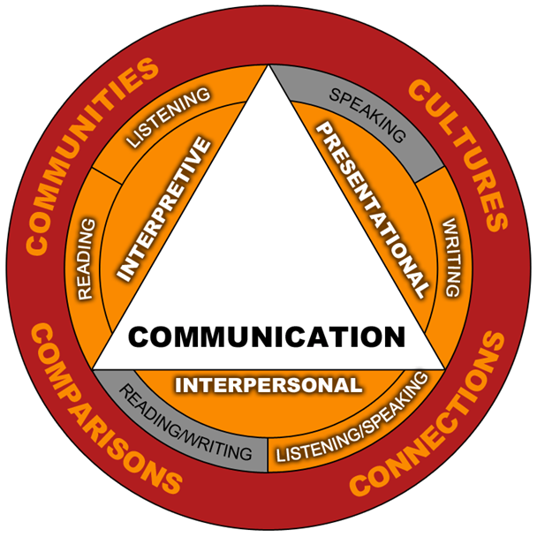
ACTFL World-Readiness Standards
for Learning Languages

Slide 20
Entre Nous!
Tell what you already know about ACTFL’s Language Standards.
Talk about the three modes of communication and the skills included in each mode.

Slide 21
C. ACTFL World-Readiness Standards for Learning Languages
Standards Summary document
Five C’s: Communication, Cultures, Connections, Comparisons, Communities
Proficiency-based (skills, not content) and spiraled.
Specific vocabulary, grammar and content are not present in the standards. Local/state districts choose the best content/curriculum for their students.
If a textbook is used, it is recommended to use it as
a resource to enhance your curriculum.
(see # 4 in “HOW TO ?” document in ODE Model Curriculum)

Slide 22
C. ACTFL World-Readiness Standards for Learning Languages
Three Modes of Communication:
a) Interpretive: reading, listening, viewing
Comprehension of a video, audio or text through reading, listening to, or viewing the source.
b) Interpersonal: speaking/listening; writing/reading Interaction with others via oral, written or signed conversations. Negotiation of meaning, exchange of opinions or information.
c) Presentational: writing, speaking, signing
Delivering information via speaking, writing or signing,
in prepared or spontaneous presentations.

Slide 23
90% Target Language

Slide 24
Between Us!
Share strategies that can help teachers and students use the target language 90% of the time.
How could we use that other “10%”?
Share challenges that you may have experienced when trying to maintain the target language in your classroom.

Slide 25
Use of the Target Language * See ODE Model Curriculum “Instructional Strategies” for more ideas
Use the target language at least 90% of the time in lower levels. Use the target language almost exclusively in upper levels. (Krashen: i + 1)
Gradually increase your target language use each day.
Improve your language skills if they are weak. Teach a different language level, if needed.
Practice ahead of time what you will say in class.

Slide 26
Use of the Target Language
5. Think about how you learned your first language:
Comprehensible input and natural repetition
Real-world tasks or authentic situations for students
Create a need for the target language
6. -Students need to HEAR the language to SPEAK the
language.
-Students need to READ the language to WRITE the
language.
7. Establish consistency of target language use across all
language levels.

Slide 27
What is Proficiency?

Slide 28
¡Entre Nosotros!
What do you think is the difference between
Performance and Proficiency in language?

Slide 29
D. Performance vs. Proficiency

Slide 30
D. Performance vs. Proficiency
Performance levels may be higher than Proficiency levels:
Example: A student may be at Intermediate Low on a unit assessment that they just practiced. (Performance)
In a spontaneous situation, the same student may now only be at a Novice High. (Proficiency)

Slide 31
D. Performance vs. Proficiency
In the heart of practice
What they remember
Where they begin
Performance
Proficiency

Slide 32
D. Importance of Communicative Proficiency
Students show how well they can communicate using any language they have acquired.
Teachers focus on what students know and can do, not what they don’t know.
Culturally appropriate interaction and communication is the overarching goal, although improving grammatical accuracy is still a goal.

Slide 33
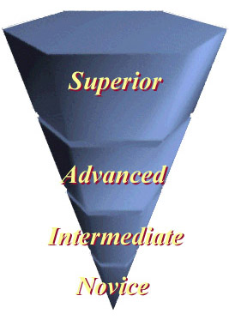
ACTFL Proficiency Levels

Slide 34
Fra Noi !
1. Tell what you already know about the ACTFL proficiency levels.
2. Have you used the ACTFL levels in your classroom?

Slide 35
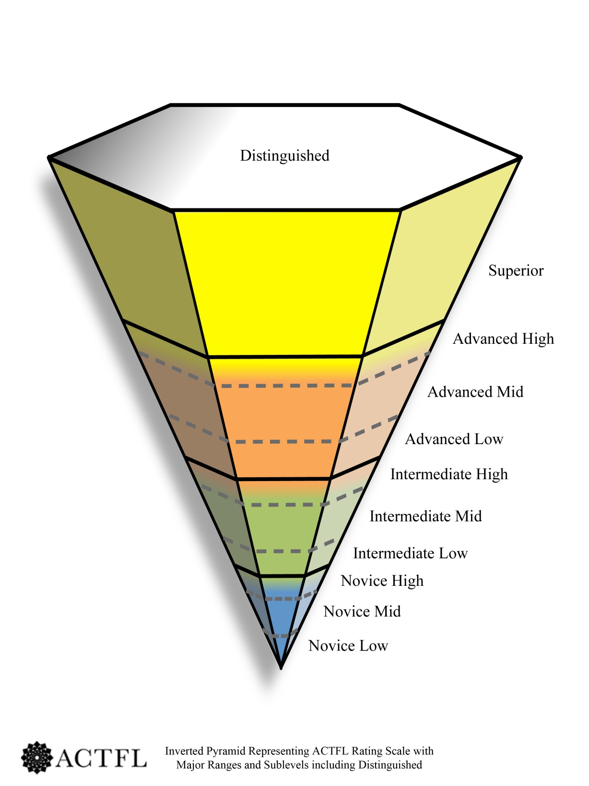
E. ACTFL Proficiency Levels
Notes:
Stress how Novice Low is the key. If the Level 1 teacher isn’t doing it, it will affect the students and teachers all they way up the pyramid.

Slide 36
E. The ACTFL Proficiency Guidelines
The ACTFL Proficiency Guidelines and Levels: http://actflproficiencyguidelines2012.org/
refer to real-world, authentic situations in a spontaneous and non-rehearsed context.
evaluate sustained, functional language ability, regardless of where, when or how the language was acquired.
describe what individuals can do with language in terms of speaking, writing, listening, and reading.

Slide 37
E. The ACTFL Proficiency Guidelines
The ACTFL Proficiency Guidelines and Levels: http://actflproficiencyguidelines2012.org/
Print the ACTFL pyramid (8.5 x 11, or 11 x 17).
Download the proficiency guidelines, by skill and level.
View writing and speaking samples of each proficiency level, in many languages.

Slide 38
E. ACTFL Proficiency Levels Defined

Slide 41
NCSSFL-ACTFL Can-Do Statements
The new 2013 Can-Do statements are aligned to the ACTFL Proficiency Levels, in student-friendly language.
They give concrete examples of what students should be able to do in reading, writing, listening, speaking, and interpersonal skills at each proficiency level.
The Can-Do statements are a good reference tool for teachers, parents and administrators, to help clarify what proficiency in a language looks like and to show the expectations for the class.

Slide 42
NCSSFL-ACTFL Can-Do Statements
The NCSSFL-ACTFL Can-Do checklists are available in the ODE Model Curriculum (under “Expectations for Learning”) and on the OFLA Weebly.
Can-Do statements are also
found on the ACTFL website
under “Publications”.

Slide 43
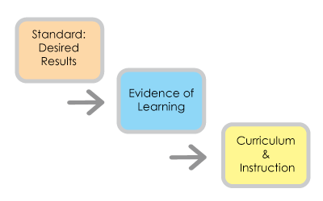
Backward Design of Units

Slide 44
F. Designing an IPA, Unit or Course
Backward Design (Wiggins and McTighe):
1. Identify desired results: Performance target, communicative/cultural goals
(e.g., students will plan what to pack for a trip to Paris)
2. Determine acceptable evidence: Performance-based assessment
(Reading from Pariscope; Converse with a friend about what to see and do in Paris; Write a packing list and tell why you need each item for the trip)
3. Plan instruction: Instructional activities, authentic resources and content
(videos, reading and websites about Paris; spontaneous conversations about what to pack for different places; relevant vocab, grammar and expressions for travel)

Slide 45
Integrated Performance Assessments™

Slide 46
Fra Noi!
1. What do you already know about IPAs?
2. How are you already using performance-based assessments with your students?

Slide 47
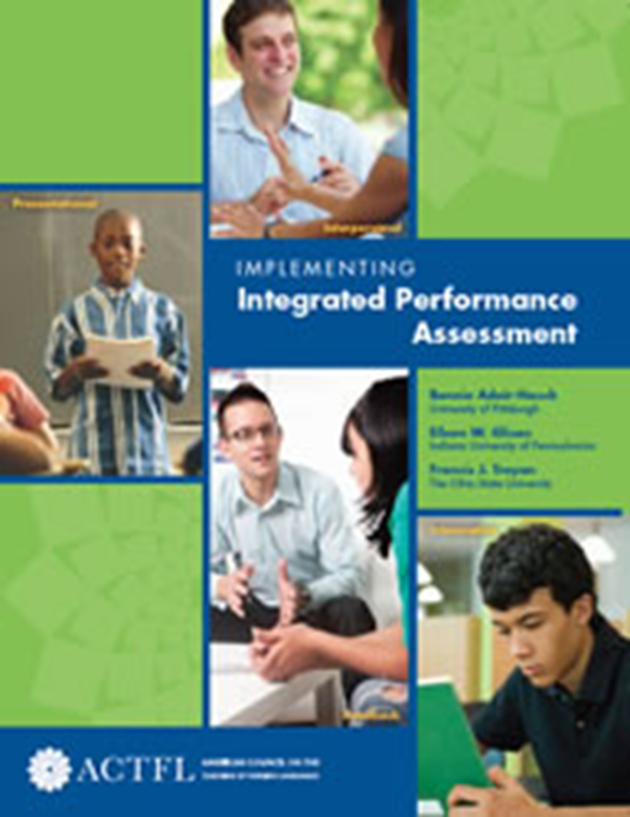
H. What is an IPA?
An IPA is a multi-task
assessment framework
designed by ACTFL.

Slide 48
H. Integrated Tasks Within A Common Theme

Slide 49
H. Three Parts of an IPA (ODE Model Curriculum link)

Slide 50
H. Where Can I Find Sample IPAs?
ODE World Languages Model Curriculum
→Instructional Strategies → Unit Samples
OFLA SLO weebly site: oflaslo.weebly.com :
Under second tab at the top: “IPA Center”
OFLA technology IPAs:
→ Livebinders.com → OFLA IPA Tech Integration

Slide 51
Increasing Depth of Knowledge
in IPA tasks

Slide 52
Interpretive Mode Of Communication

Slide 53
Zwischen uns !
In a reading or listening task,
what should students be able to do?

Slide 54
J. Interpretive Communication

Slide 55
K. Developing Interpretive Tasks Using the ACTFL template - Appendix D

Slide 56
K. Developing Interpretive Tasks Using the ACTFL Template – Appendix D
Literal Comprehension
Key word recognition
Main idea
Supporting details
Interpretive Comprehension
Organizational features
Guessing meaning from context
Inferences
Author’s perspective
Comparing cultural perspectives
Personal reaction to the text

Slide 57
K. ACTFL Rubric for Interpretive Tasks Appendix F

Slide 58
K. Sample Interpretive Activities
Interpretive Reading and Listening Activities
Share Listening and Reading activities that you do with your students.

Slide 59
Using Authentic Resources in Interpretive Tasks

Slide 60
Entre Nós!
1. What would make a resource culturally “authentic” vs. “not authentic”?
2. What are benefits of using authentic cultural resources with your students?

Slide 61
L. What is “Culture” ?
Products (the What):
monuments, laws, music, etc.
Practices (the How):
eating or shopping habits, use of space, etc.
Perspectives (the Why):
values, attitudes, beliefs, etc.

Slide 62
L. How Can I Embed Culture Into My Lessons?
The NCSSFL Intercultural Can-Do statements give concrete ideas for embedding culture into your lessons, in the target language.
The Culture Can-Do Checklists can be found in the ODE Model Curriculum, under “Expectations for Learning”.
Checklists can be given to students, parents and administrators to clarify the cultural learning goals for the course.

Slide 63
L. What is an Authentic Resource?
An audio, video, or text made by native speakers for native speakers.
It gives a distinct native perspective of the target culture and its people by providing a real-life experience of the products and practices of that culture.
An authentic resource has not been modified or simplified for language learners.*
*Many textbook resources have been modified or simplified.

Slide 64
L. What Type of Authentic Resource Should I Use?
Is it age-, level-, and context appropriate? Is it real-world or interesting for my students?
Is it well-organized, with contextual support and visuals that match the text?
Could the resource be used across many levels? Use excerpts from the resource, if needed, but don’t change it. Modify your task instead.
The goal is for students to grapple with the resource and make meaning from it.

Slide 65
L. Where Can I Find Authentic Resources?
Ohio Department of Education Model Curriculum for World Languages: Instructional and Authentic Resources
FLTeach: http://web.cortland.edu/flteach/flteach-res.html
Deutsche Welle - current events in 30 languages: ww.dw.de
Ver Taal - Spanish, French: www.ver-taal.com
Youtube. Google images. Google (.fr / .es/ .de / etc.)
GO-TO List of World Language Resources

Slide 66
L. Między Tobą A Mną!
1. What are appropriate authentic resources for lower level students?
2. Share your “Go-To” sites for authentic resources.

Slide 67
L. Teaching Grammar Inductively Using an Authentic Resource
Share ways that you teach grammar inductively with your students.

Slide 68
Interpersonal Mode
of Communication

Slide 69
Entre Nous!
Share examples of interpersonal speaking, writing, or signing tasks that your students do.

Slide 70
M. Interpersonal Communication

Slide 71
M. Interpersonal Ideas and Samples
Interpersonal Ideas and Samples

Slide 72
M. Logistics for Assessing Interpersonal Speaking
How do I keep the other students busy
while I’m assessing?
Google Voice, or other voice programs
Current book, literature, project
Do speaking in computer lab while students work on projects, online activities, teacher webpage, etc.
Show a movie, bring students into hall in groups or individually.
Group sharing of other strategies:

Slide 73
Presentational Mode
Of Communication

Slide 74
¡Entre Nosotros!
Share examples of presentational speaking, writing, or signing tasks that your students do.

Slide 75
N. Presentational Communication

Slide 76
N. Sample Presentational Tasks
Presentational Activity (spontaneous)
Presentational Activity (polished)
Other ideas
Group sharing of other ideas.

Slide 77
Zwischen uns !
Now that you know more about IPAs…
…discuss the benefits of using a
performance-based assessment of language, instead of a multiple choice or grammar-based test.

Slide 78
IPA: End-of-unit vs Year-end

Slide 79
O. IPA: End-of-unit vs Year-end
IPA for French 1:
An IPA created for a unit on “Travel”.
The same IPA modified for a final exam.
Exchange student IPA from year to year.

Slide 80
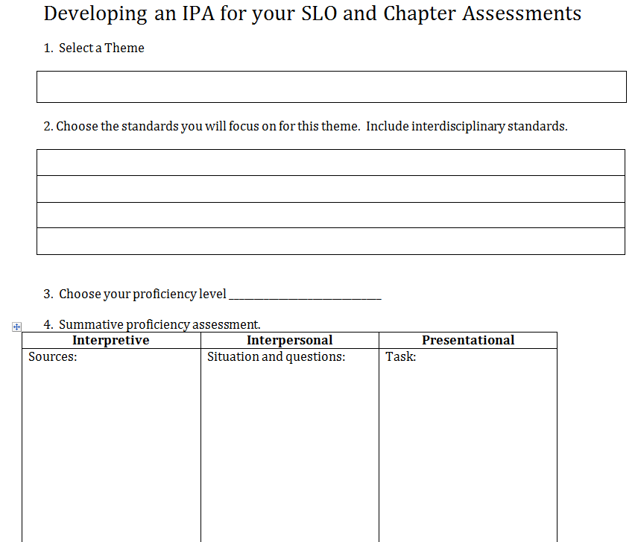
Designing an IPA and Unit (handout)
See p. 22 and your extra handouts for this IPA template.
Jot down ideas for your IPA as we go through the workshop (themes, activities, resources, etc.)

Slide 81
Designing an IPA and Unit (handout)
Choose a theme and a communicative context .
Choose the standards that you will focus on.
Choose the proficiency level you are targeting.
Choose an authentic resource and the tasks for the IPA (interpretive, interpersonal, presentational)

Slide 82
Designing an IPA and Unit (handout)
Determine the functional language (relating an event, describing people, asking questions…)
and the content (grammar and vocab) that your students need to know in order to succeed.
Design activities for formative assessments and learning checks (interpretive, interpersonal and presentational activities, vocab and grammar practice).

Slide 83
Summative Assessment
Interpretive: Read the article about the grading system and tell me if you like it or would it be better to keep the one we have.
Interpersonal: Skype and communicate with a native speaker about his school. This can also be a practice and the conversation could be a phone call to your friend at home telling about the new school.
Presentational: Write a letter to your mom about how your school is different from the school you are attending with your host brother/sister.

Slide 84
Designing a unit
Decide what functional language you need to teach for them to be successful (in other words vocab and grammar)
Design activities for formative assessments
interpretive
interpersonal
presentational

Slide 85
Designing a unit
Functional language
school vocabulary
comparisons
how long...
affirmative and negative ideas
anything you need or want to incorporate to make the road a bit smoother for the students

Slide 86
Design a unit
Look at class schedules from different Hispanic schools
Talk about the schedules with partners
make comparisons of schedules with their own schedules
review/teach comparisons in context here

Slide 87
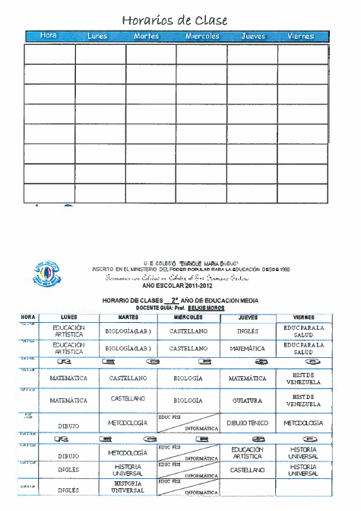
Design a unit

Slide 88
Design a unit
Look at art from Simón Silva “El día del maestro”

Slide 89
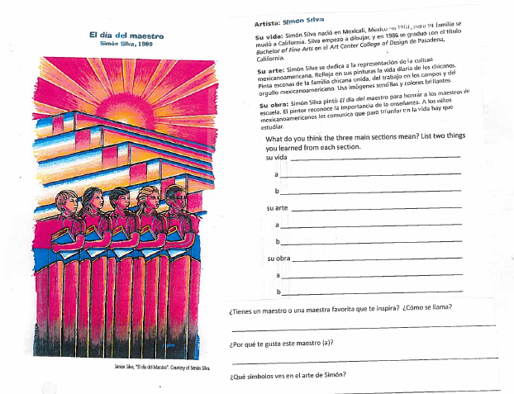

Slide 90
Design a unit
Listen to student talking about a school day

Slide 91
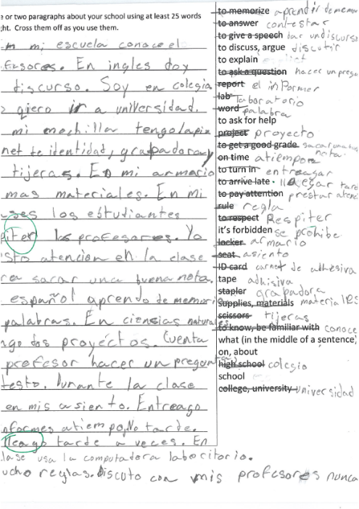
Formative

Slide 92
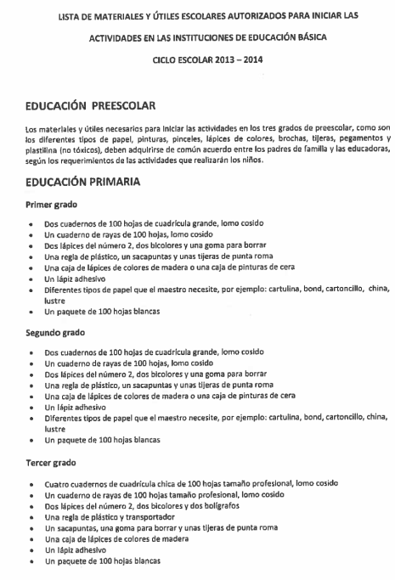

Slide 93
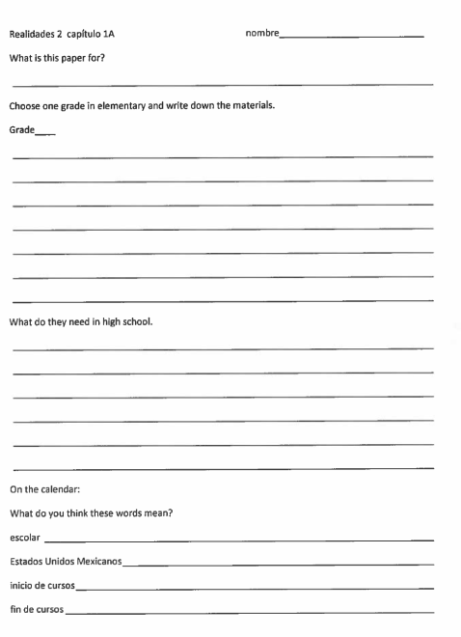

Slide 94
Vocabulary
Choices-
Not only what is in
the book.

Slide 95
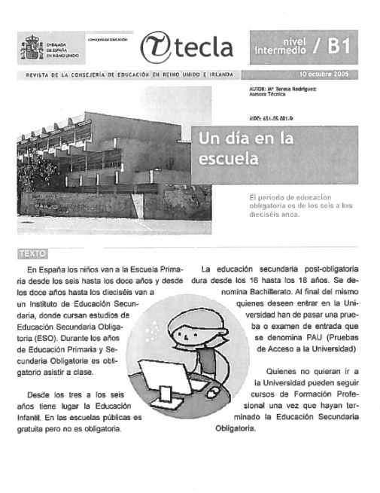

Slide 96
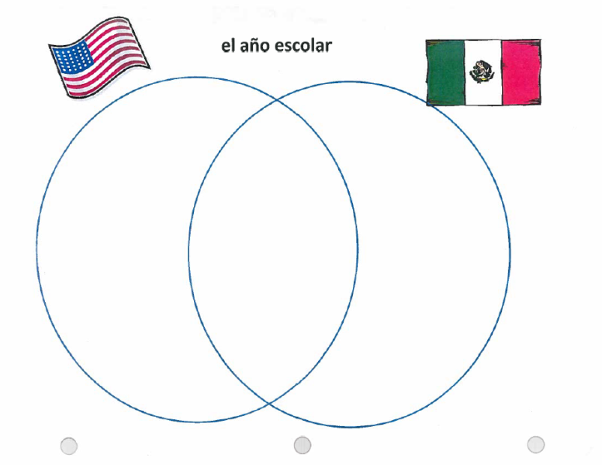

Slide 97
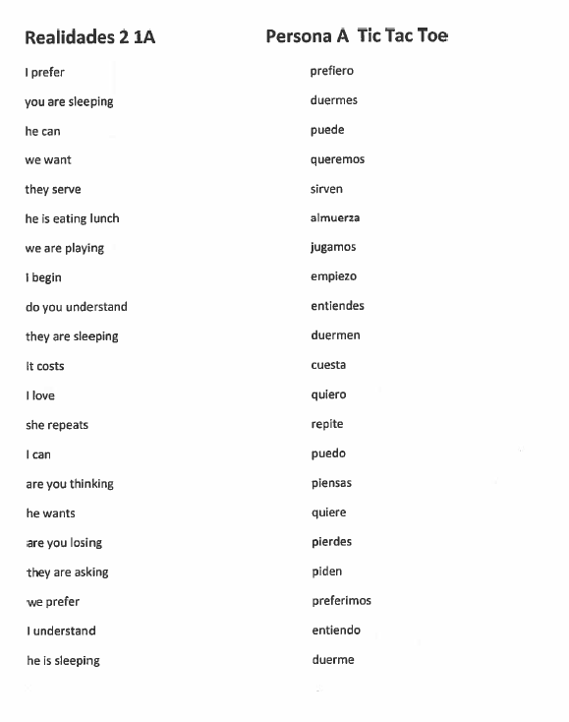
Practice

Slide 98
I. Why use an IPA?
IPAs are performance/proficiency-based assessments and align with World Language standards.
IPAs match recommended instructional best practices for world languages (i.e., assessment guides instruction).
An IPA can be used as a summative assessment of performance at the end of a unit, mid-term exam, and final exam.
Teachers can collaborate with colleagues to develop IPAs. You don’t have to teach the same language or level. Find a similar resource in your language and develop the IPA tasks together.

Slide 99
I. What Type of Tasks are in an IPA?
Describe clearly what the task is, for each mode.
Students use critical thinking skills to accomplish the task (predict, justify, summarize, infer, etc.). (Bloom’s Taxonomy for World Languages – Hedstrom).
Tasks should have “stretch” to allow students of all abilities to show their language proficiency. The task may have a floor (minimum requirements) but shouldn’t have a “ceiling”.

Slide 100
I. What Type of Tasks are in an IPA?
4. Use a resource that gives the tasks a real-world context:
Videoclip, article, poem, picture, catalog page, weather report, ad, graph, chart, survey, schedule, blog, tweets.
5. Ensure that the tasks are age-, level-, and context appropriate. Could the tasks be modified to be used at various levels? (e.g., students use different verb tenses to complete the task, depending on the level). 6. Choose tasks/contexts that are real-world and/or relevant to your students’ lives: - Teach someone how to__; - Write a text, tweet, facebook or blog post; - Write a survey for your classmates; - Compare music in the US and France; - Summarize a story, plot or character.

Slide 101
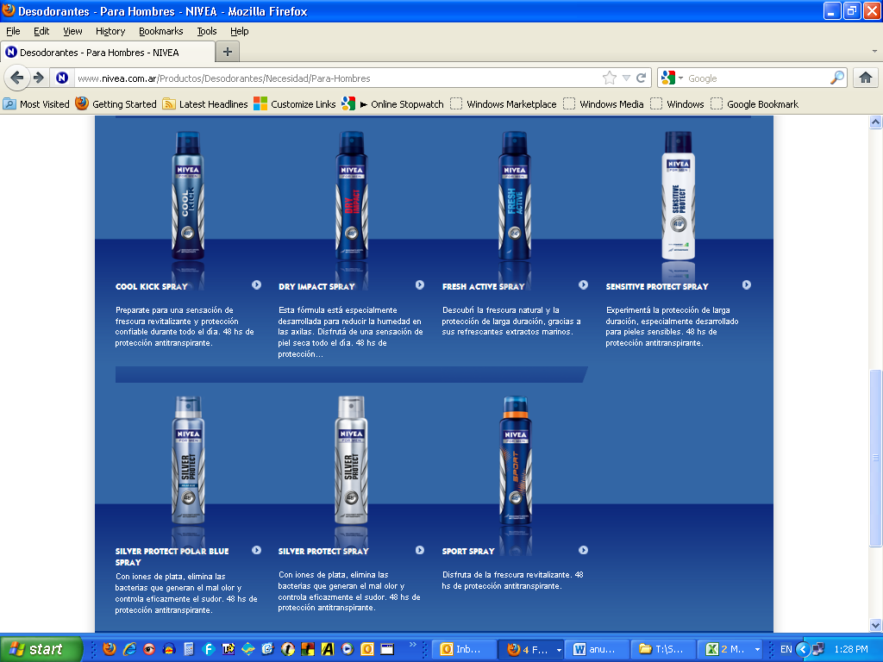
Small Group Creation of IPA Tasks
Deodorant Ad in Spanish
a) View Interpretive questions (link)
b) Create an Interpersonal Task (oral or written)
c) Create a Presentational Task (oral or written)

Slide 102
P. Stretching IPA Tasks Across Levels
See p. 24 for this IPA template for stretching tasks across levels.

Slide 103
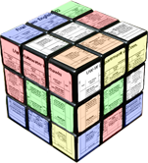
+
Rubrics

Slide 104
Zwischen uns !
Do you already use rubrics for scoring?
What are the benefits of using rubrics?
What are concerns you may have?

Slide 105
Q. Rubrics
http://education.ohio.gov/getattachment/Topics/Ohio-s-New-Learning-Standards/Foreign-Language/World-Languages-Model-Curriculum/World-Languages-Model-Curriculum-Framework/Instructional-Strategies/Strategies_Assessment_Guidance_MCwebsite.pdf.aspx

Slide 106
Q. Rubrics
http://education.ohio.gov/getattachment/Topics/Ohio-s-New-Learning-Standards/Foreign-Language/World-Languages-Model-Curriculum/World-Languages-Model-Curriculum-Framework/Instructional-Strategies/Strategies_Assessment_Guidance_MCwebsite.pdf.aspx

Slide 107
Q. Rubrics
http://education.ohio.gov/getattachment/Topics/Ohio-s-New-Learning-Standards/Foreign-Language/World-Languages-Model-Curriculum/World-Languages-Model-Curriculum-Framework/Instructional-Strategies/Strategies_Assessment_Guidance_MCwebsite.pdf.aspx

Slide 108
Q. Rubrics
ODE rubrics, coming this summer.
http://education.ohio.gov/getattachment/Topics/Ohio-s-New-Learning-Standards/Foreign-Language/World-Languages-Model-Curriculum/World-Languages-Model-Curriculum-Framework/Instructional-Strategies/Strategies_Assessment_Guidance_MCwebsite.pdf.aspx

Slide 109
Q. OFLA Rubrics
OFLA rubric for end-of-unit Performance
http://oflaslo.weebly.com/performance-rubrics.html#.VOOG_KEo6Hs
OFLA rubric for Proficiency
http://oflaslo.weebly.com/proficiency-rubrics.html#.VOOHGKEo6Hs

Slide 110
References
Adair, Glisan, Troyan. Implementing Integrated Performance Assessments. American Council on the Teaching of Foreign Languages, 2013
Sandrock, Paul. The Keys to Assessing Language Performance: A Teacher's Manual for Measuring Student Progress. American Council on the Teaching of Foreign Languages, 2010
American Council on the Teaching of Foreign Languages, 2015. www.actfl.org
Battelle for Kids, 2015. FIP Your School Ohio. http://portal.battelleforkids.org/FIPOhio
Kentucky Department of Education, 2015. http://education.ky.gov/curriculum/wlang
National Council of State Supervisors for Languages, 2015. www.ncssfl.org
OFLA Weebly, 2015. http://oflaslo.weebly.com
Ohio Department of Education, 2015: http://education.ohio.gov
Ohio Foreign Language Association, 2015. http://www.ofla-online.org/

